Slide 1
Rethinking the business/charity divide
Creating innovative ways of achieving social impact and building the kingdom in sustainable ways. How can the Church encourage such entrepreneurship?

Slide 2
Outline
Kingdom building
Moving beyond local church based social action

Slide 3
Kingdom building
“Then he sent them out to tell everyone about the Kingdom of God..” Luke 9v2
145 references to the Kingdom in NT
“Therefore, go and make disciples of all the nations..” Matt 28v18
“Those who believed what Peter said were baptized and added to the church that day—about 3,000 in all.” Acts 2:41
“Now these are the gifts Christ gave to the church: the apostles, the prophets, the evangelists, and the pastors and teachers. Their responsibility is to equip God’s people to do his work and build up the church, the body of Christ.” Ephesians 4v11-12
Notes:
Jesus spoke more about the Kingdom of God than the Church
(Matthew 16:18 - Now I say to you that you are Peter (which means ‘rock’), and upon this rock I will build my church, and all the powers of hell will not conquer it.)
Our role as disciples is to go and make disciples wherever we are by telling them about the Kingdom of God.
As a business person, I must admit some guilt and frustration about how this has been interpreted in practice. I will generalise here but I’m sure some of you will have experienced this. The expectation has been that we need to go and make disciples of our neighbours and add them to the church we are part of. So we have very busy days at work which is often miles away from the church we attend, rush back, grab dinner, hardly see the family as we have to be out to a church event, etc.
If we had a Kingdom mentality, we would be making disciples wherever we are and helping people on their spiritual journey to be added to the Church wherever that might be for them. The communities we spend most of our time in, often 40-50 hours per week and have relationships built i.e. workplaces, often are miles from the town where we live.
The Ephesian 4 ministries should be used to equip and release you to do his work in those places. We are workplace ministers. Missionaries are sensitive to the culture they work in and we need to hear discussion on Kingdom building approaches in the communities where we spend most of our time. For example, when was the last time you heard teaching on evangelism in the workplace, the provision of workplace alpha courses, prayer for your ministry at work, etc?
This is a big subject which I cannot cover here but it would be helpful for the rest of the presentation to have a Kingdom mindset.

Slide 4
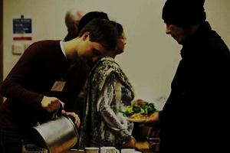
Churches respond significantly to local social challenges 2012
Volunteer hours on local social action increase by 36% in 2 years to 98M hours.
Funds spent on social action increase by 19% in 2 years to £342M.
Average number of social initiatives undertaken by a church has risen from 5.7 to 8.2.

Slide 5
Churches respond significantly to local social challenges
Biggest Encouragements:
Community involvement;
Attendance at events/ growth;
Changing us;
Meeting needs;
Appreciation/ Recognition
Biggest Hindrances:
Volunteers/ time;
Funding;
Vision/ Leadership;
Ageing Congregation;
Premises/ Equipment
Staffing/ Management

Slide 6
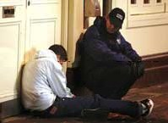
Focused Volunteering
Crisis Intervention
Community Cohesion
Relationships
Mothers & Toddlers
Schools work
Fun days
Lunch Clubs etc.
Debt
Employment
Educational Failure
Addiction
Notes:
Churches are being equipped by social franchises to engage effectively in social action. I’ve identified about 40 of these.
Click
As well as traditional activities which I have grouped as community cohesion, CLICK, Churches are being equipped for Crisis intervention eg food distribution to poor families that are referred to them (food is donated from supermarkets, donors, etc).
Click
but also we have seen the emergence of franchises for some of the root causes. Debt, Employment, etc.
Remember, these are very rarely grant aided initiatives.
All social actions lead to church growth to a small or greater extent.

Slide 7
Kingdom social action responses
Local church
Social enterprises
Workplace social action
Charities
Notes:
As well as the social actions facilitated by local churches and their congregations, perhaps in partnership with other churches, we are also familiar with Christians volunteering and supporting charities.
But now to come at last to social enterprises and also actions within a business workplace thinking with a Kingdom mindset.

Slide 8
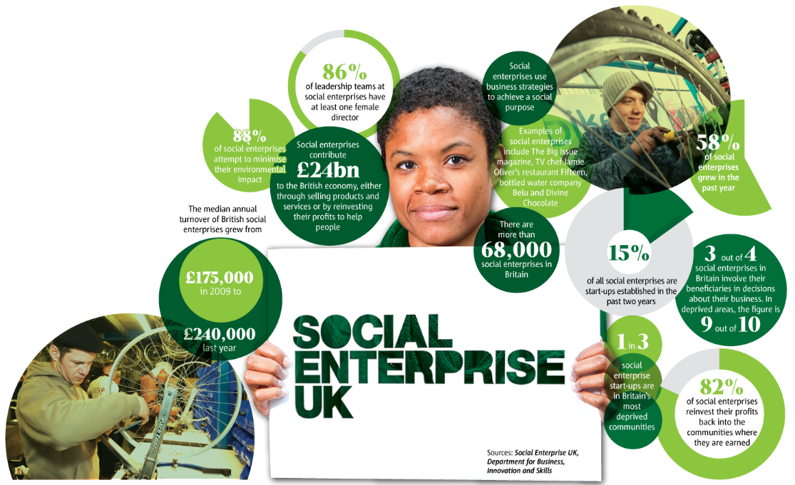
Social Enterprise
Notes:
First I want to explain a little about the UK social enterprise sector.
SE UK published some latest stats in Nov 2012 . I’ll pick some of them out.
68,000 social enterprises – 9000 started in last 2 years. They contribute £24bn to the economy.
Median turnover increased since 2009 from £175k pa to £240k pa – up 37%.
1 in 3 are in Britain’s most deprived communities.
82% reinvest their profits back into the communities where they are earned.
Very few are church initiated.

Slide 9
Social Enterprises - doing business, doing good
Employing people with disabilities
Notes:
These organisations, which can often be a charity, a co-operative or a Community Interest Company (CIC), are taking more than half of their profits and either reinvesting it in their business or putting it directly towards good causes.
My observations as to type of enterprises are:
Supervision and leadership by skilled personnel is essential.
a) Employing people with disabilities – long term employment
CLARITY is a manufacturer of soaps and toiletries aiming to provide opportunities for blind and disabled people to play a full part in society.

Slide 10
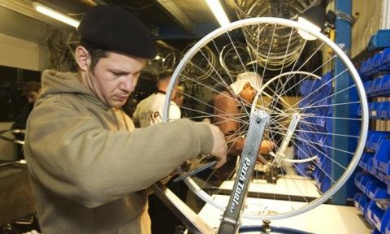
Social Enterprises - doing business, doing good
Employing people who find it hard to get jobs due to life choices e.g. ex-offenders, etc.
Notes:
b) Employing people who find it hard to get jobs due to life choices e.g. ex-offenders, etc. – shorter term employment with the object of getting an NVQ, etc. - a stepping stone into the world of work.
Bikeworks tackles environmental issues by getting more people cycling & recycling used bikes for re-use whilst at the same time creating employment & training opportunities for disadvantaged communities. Jamie’s 15.
These enterprises can also serve the vulnerable e.g. garden maintenance for vulnerable in social housing. This is a win-win. The businesses mainly focus on manual labour, relatively low skill activities e.g. decorating, gardening, catering.

Slide 11
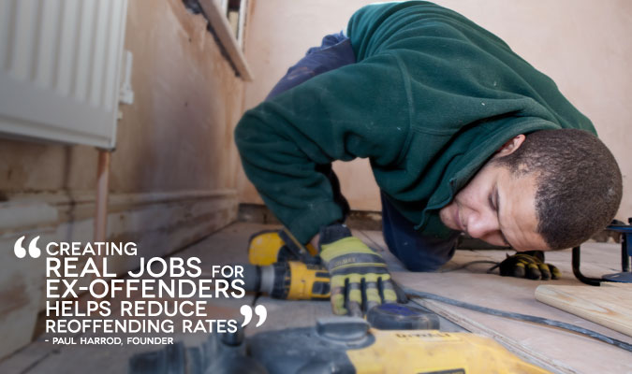
Social Enterprises - doing business, doing good
Bristol Together
Notes:
Bristol Together CIC is a new social enterprise partnership that launched in October 2011.Our aim is to create full-time jobs for long-term unemployed people, and ex-offenders in particular.
They do this by buying empty properties, and working with social enterprise partners to employ ex-offenders in all aspects of the repair, refurbishment and restoration. Once the properties are fully restored they are then sold, and the original capital, plus any profits, reinvested back into the business to finance further property purchases, and further job creation.
All the employees are mentored and supervised by highly experienced project managers. They hope that the skills and experience they develop as a result of their employment with BTogether will be the launch-pad to accessing other full-time jobs in the future.
Bristol Together started in October 2011 after raising £600 000 in investment capital. They then raised a further £1 million in May 2012 to complete our first Social Impact Bond.
We are working with Triodos Bank to explore the possibility of replicating, or developing our social enterprise in other cities in the UK. In Bristol we expect over the course of the next five years to create jobs for up to 200 ex-offenders, and to bring over seventy empty properties back into use.

Slide 12
Social Enterprises - doing business, doing good
Turning the experience of crisis or disability into an earning opportunity e.g. testing disabled access
Notes:
c) Turning the experience of crisis or disability into an earning opportunity
Shaw Trust tests websites.

Slide 13
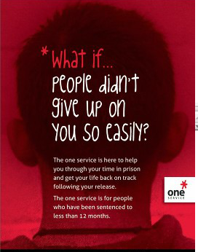
Social Enterprises - doing business, doing good
Payment by results
Notes:
d) Payment by results
One Service Social Impact Bond Peterborough

Slide 14
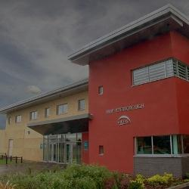
Example - Social Impact Bonds
The Peterborough Example
Funds organisations working to reduce the re-offending rates
£5m has been raised from investors
The problem and costs
Payment on Outcomes
Notes:
A Social Impact Bond in Peterborough funds organisations working to reduce the re-offending rates of short sentence male prisoners leaving Peterborough Prison. £5m has been raised from investors which is new money into the sector.
60% of young male offenders serving 12months or less re-offend and are back in prison within 12 months of release. That year costs public services £40,000.
If you can reduce re-offending rates, the savings can be shared with the service that is working with the offenders.
A Social Impact Bond raises private investment to pay for services, which are delivered by social sector providers with a proven track record. Financial returns to investors are funded by the Ministry of Justice and are based on improved social outcomes. If outcomes do not improve, then investors will receive no recompense. If re-offending rates reduce by 7.5% or more, investors will receive up to 13% returns.

Slide 15
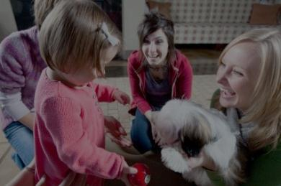
Example - Social Impact Bonds
More are launched:
Vulnerable Children
Employment
Homelessness
Notes:
Vulnerable Children 11-16 year olds at the edge of care or custody in Essex. Providing support so that the young people can safely remain at home with their families, with the aim of substantial improvements in their long term outcomes.
Residential care costs £150,000 - £180,000 per annum for a child. 25% of all prisoners have been in care compared to 2% of the population overall. Educational attainment by looked after children is five times worse than for the population overall.
Employment - Social Impact Bonds will fund interventions to work with around 2,500 14-15 year olds who are disadvantaged or at risk of disadvantage to help them participate and succeed in education or training and thereby improve their employability.
Homelessness - Housing Minister Grant Shapps and London Mayor Boris Johnson announced in March 2012 that a Social Impact Bond would be launched to help London's persistent rough sleepers off the streets and into secure homes. The two Social Impact Bonds under this programme were launched in December 2012.

Slide 16
Social Enterprises - doing business, doing good
Giving all profits away
Notes:
e) Normal businesses but they give their profits away
Belu water is the most ethical water brand in the UK, being 100% carbon neutral and giving all of its profits to leading clean water charity, WaterAid.

Slide 17
Social Investment
Most investment opportunities seen have been long term, illiquid, debt or quasi-equity and unclear about risk.
Seeding new ventures - examples
Cabinet Office Social Incubator Fund
Nesta Impact Investments
Social Enterprise Challenge Fund
Big Venture Challenge Fund
Notes:
There is a lot of weak businesses around. Need to stress that businesses must be financially sound first, social action second ie sustainable. Must not rely on volunteers or grants (or though might be started this way).
Very few are investable.
What is also apparent is that for all the social ventures, many have not reached an investment stage.
So in the last year we’ve seen some government and foundation help in this regard.
Social Incubator Fund – financing orgs that will create incubator hubs across UK.
Nesta – investing in early stage ventures
Social Enterprise Challenge Fund - £4k
Big Venture - £50k - £250k

Slide 18
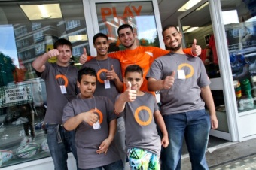
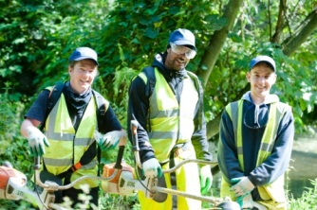
Increasing Social Impact in Businesses
1. Getting existing businesses more socially active e.g. employing some disadvantaged people
2.Using social enterprises in the supply and service chain
3. Bringing in a social enterprise’s products into a commercial business
Notes:
Now If you not entrepreneurial there are still options to build the kingdom through social action.
I’d like to switch to the workplace.
What if existing businesses went beyond the present CSR norms?
What are the options for increased social benefits.
a) Creating a branch that is more socially active.
Picture is Circle Sports is a sport shop, trading in Westminster, with the core purpose to get local NEET’s (young people (many are 18-24) currently Not in Employment, Education or Training) into permanent employment, and apprenticeships. They focus on the retail sector.
Through a thirteen week job preparedness programme, NEETs gain, practical customer service, business management, marketing and retail skills via voluntary work in the shop or in other local businesses and partner organisations. Circle Sport’s target is to place 60% of local NEET’s who complete the programme in to permanent employment and apprenticeships – to date eleven out of fifteen participants have now been placed in permanent jobs (in Espirit, Maplin, Primark, Super Dry and William Hill), and five more in apprenticeships/internships, competing with the open market in the first six months. The plan is to get 60-80 youngsters placed in the next year and open other outlets in London Boroughs. Could be linked to NVQ or Apprenticeships
Could be for a fixed period
NEETs focused?
Needs internal management
b) Using social enterprises in the supply and service chain e.g. painting/decorating (Blue sky/Grow org), recycling (M&S/Oxfam Shwop campaign), product supply
Partnership opportunity – brand leverage
Externally managed
Covers NEETs, Disabled, Ex-offenders
Must deliver on time and to quality
Needs scale
c) Bringing in a social enterprise’s products into a commercial business.
As a social enterprise, Rubies in the Rubble tackles food waste and unemployment through the production of chutneys made from surplus fruit and vegetables whilst providing training and employment opportunities for low-income women.
More Visible Social Link
Partnership opportunity
Externally managed
Covers NEETs, Disabled, Ex-offenders
Must deliver on time and to quality
Needs scale

Slide 19
Increasing Social Impact in Businesses
Relationships
Handling Money
Notes:
Running some social actions

Slide 20
Increasing Social Impact in Businesses
Taking on a commercial franchise that meets social needs.
Notes:
For the less entrepreneurial there is an option we are investigating now about taking on a commercial franchise that has high social impact. Franchises are meant to have less risk of failure but still need good business acumen.
I’ve identified 11 such franchises. Elderly care is an obvious sector. I will not comment further as we are still developing our thoughts on this.

Slide 21
Rethinking the business/
charity divide
Ephesian 4 ministries should equip disciples for kingdom building where ever they are.
Christians need to have the vision and passion to see themselves as workplace ministers
For new businesses, they need the entrepreneurial drive and motivation to make it happen
The character necessary to persist through setbacks, learn from experiences and involve others
Business plans need to be robust.
Existing businesses can increase social impact through use of social enterprises to supply and in workplace social action.

